Slide 1
LEGOLAS
3D Printing Guide

Slide 2
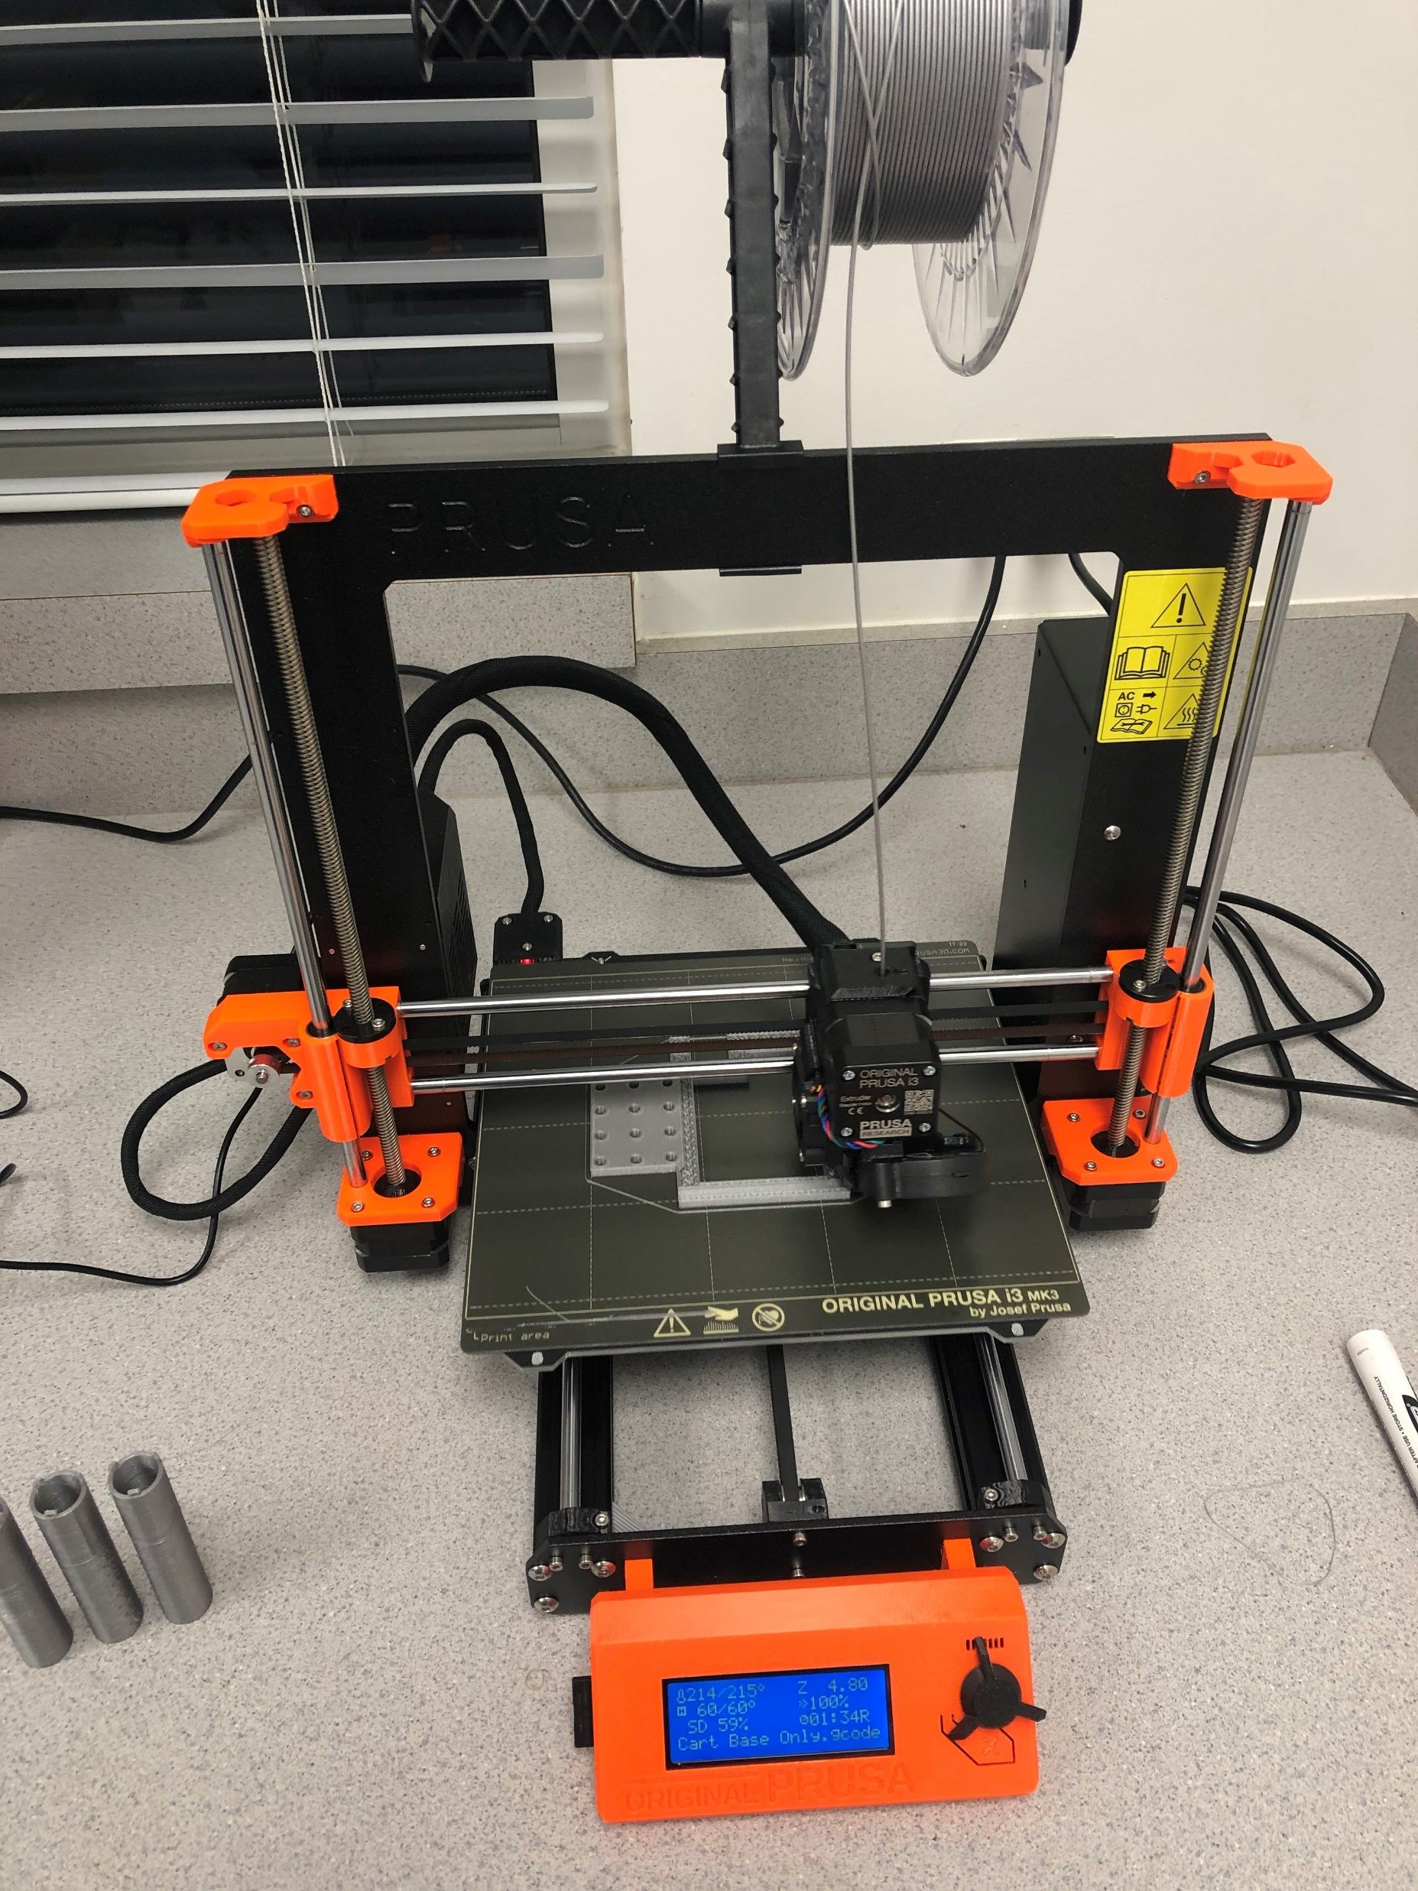
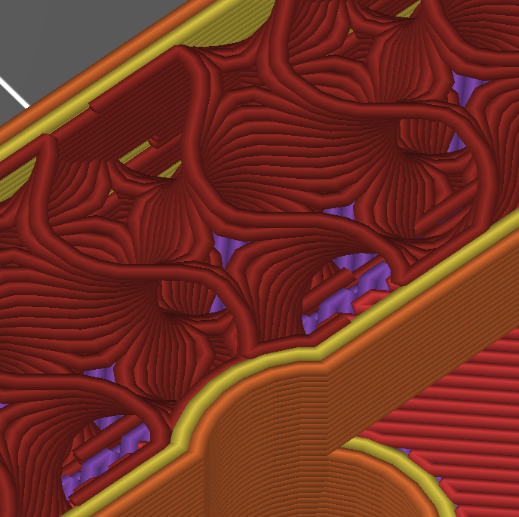
Printing Details
Printer: Original Prusa i3 MK3S
Filament Material: Prusament PLA (Galaxy Silver)
Filament Diameter: 1.75 mm
Layer Height: 0.20 mm
Infill %: 15
Infill Pattern: Gyroid (others can be used as well)
Maximum Part Dimensions (vertical): 5.51” (pH guide tube component)
Maximum Part Dimensions (horizontal): 5.94” (trolley base component)
Extruder/Plate Temp: 215°C / 60°C
Total Material Needed (All Prints):
Estimated Total Material Cost* (All Prints):
Many prints can be grouped together on the same job/plate to lower total print time
Files (.3mf, .stl, .f3dm, .obj, .gcode) provided for each component
Only use g-code for same printer type used here
Can modify the parts using the .f3dm file using Autodesk Fusion360 CAD software
Information on optimal part orientation & support material usage for each component is in the following pages
Additional printer setting details are included at the end of the document
*based on $30.24/kg filament pricing
15% Gyroid Infill
Prusa i3 MK3S

Slide 3
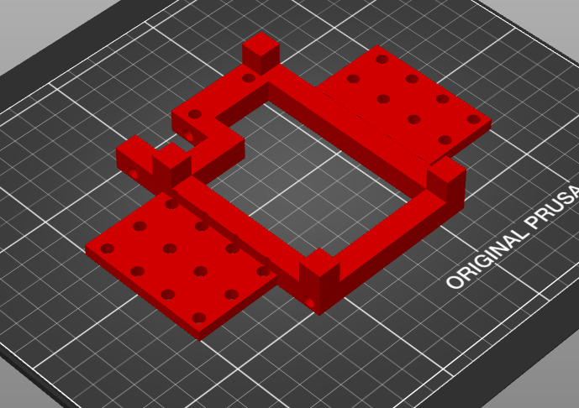
Trolley Base
Quantity Needed: 1
Supports: None
Post processing: Use drill press to bore out axle holes (5mm or 3/16”)
PLA used: 38.71 g
Estimated PLA cost: $1.17
Estimated Print Time: 3.5 hours
Orientation

Slide 4
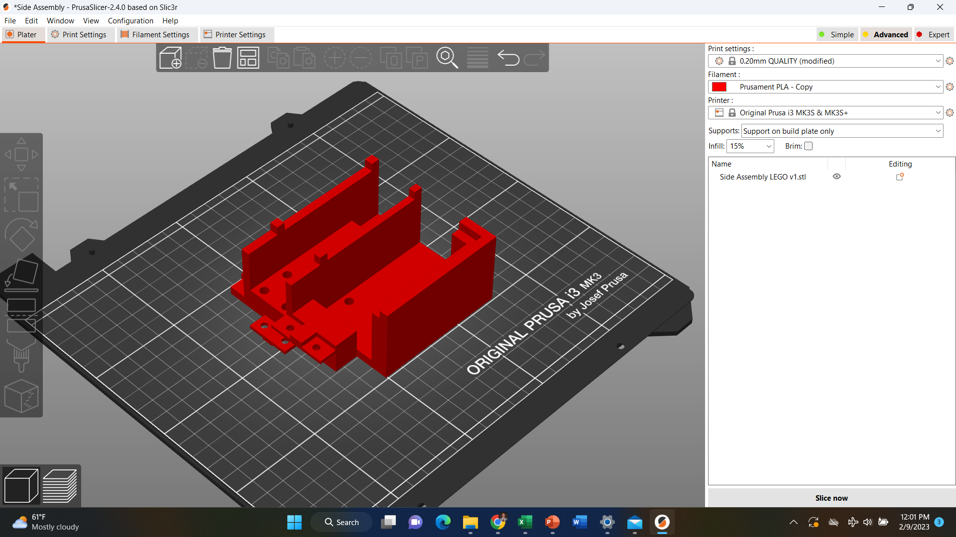
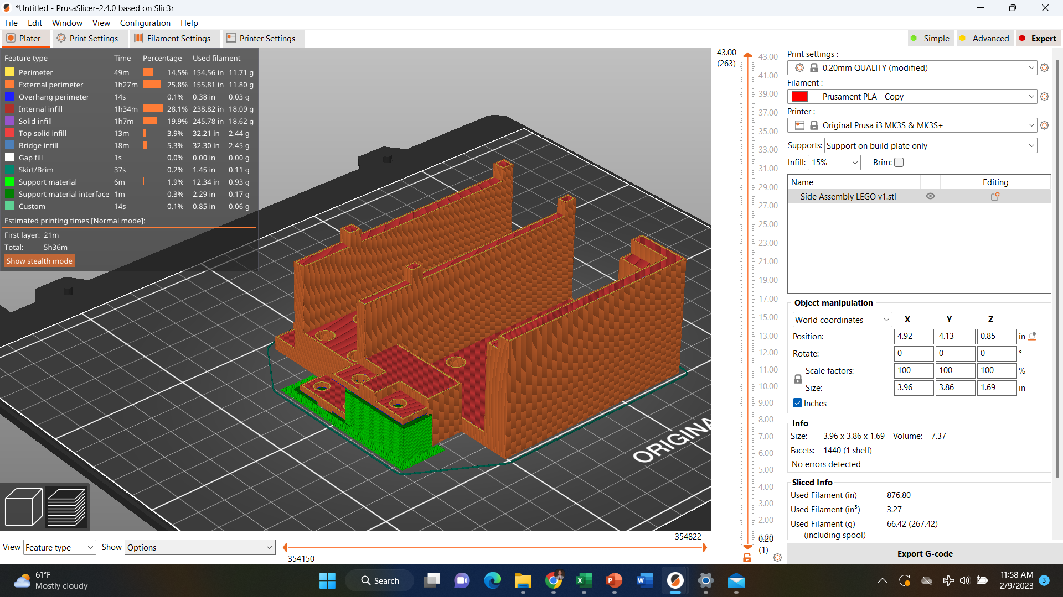
Side Assembly
Quantity Needed: 1
Supports: Yes (on build plate only)
Post processing: Remove support material carefully
PLA used: 66.42 g
Estimated PLA cost: $2.01
Estimated Print Time: 5.5 hours
Orientation
w/Supports

Slide 5
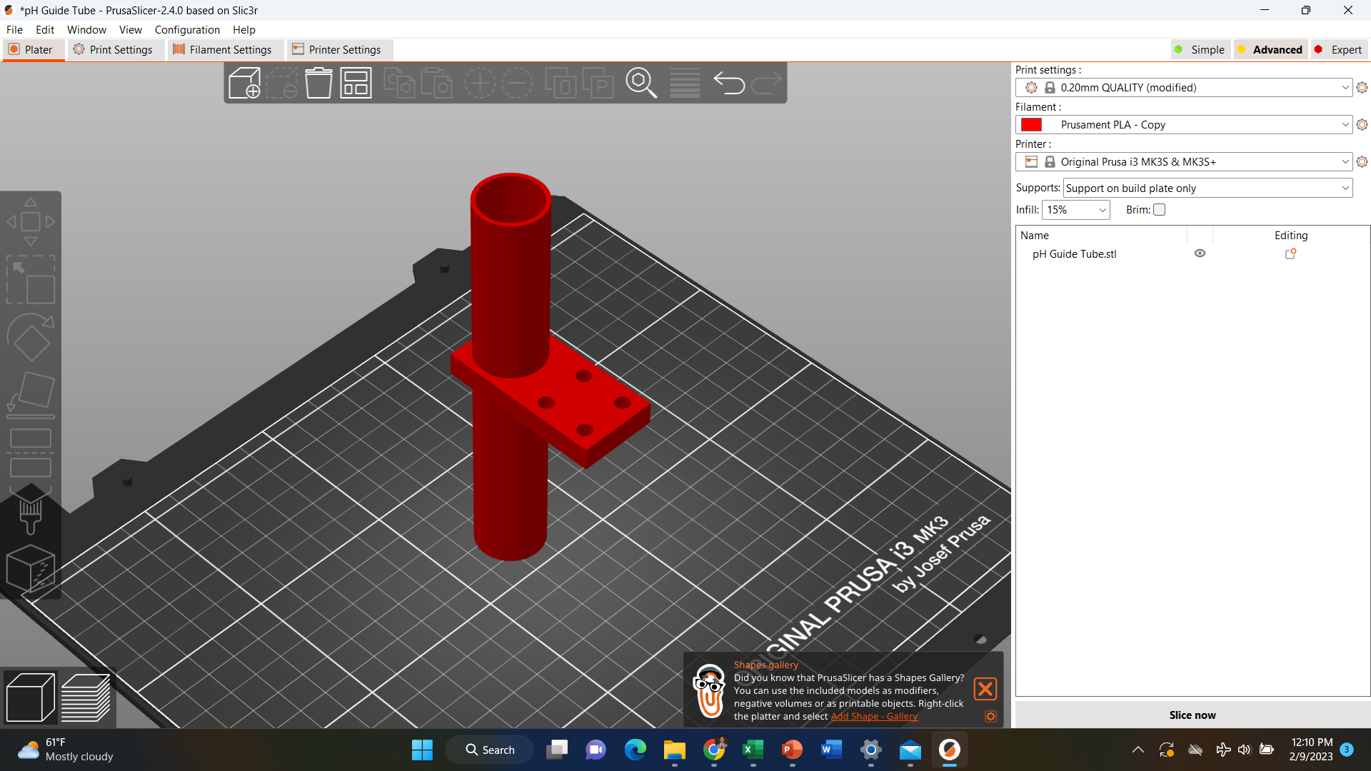
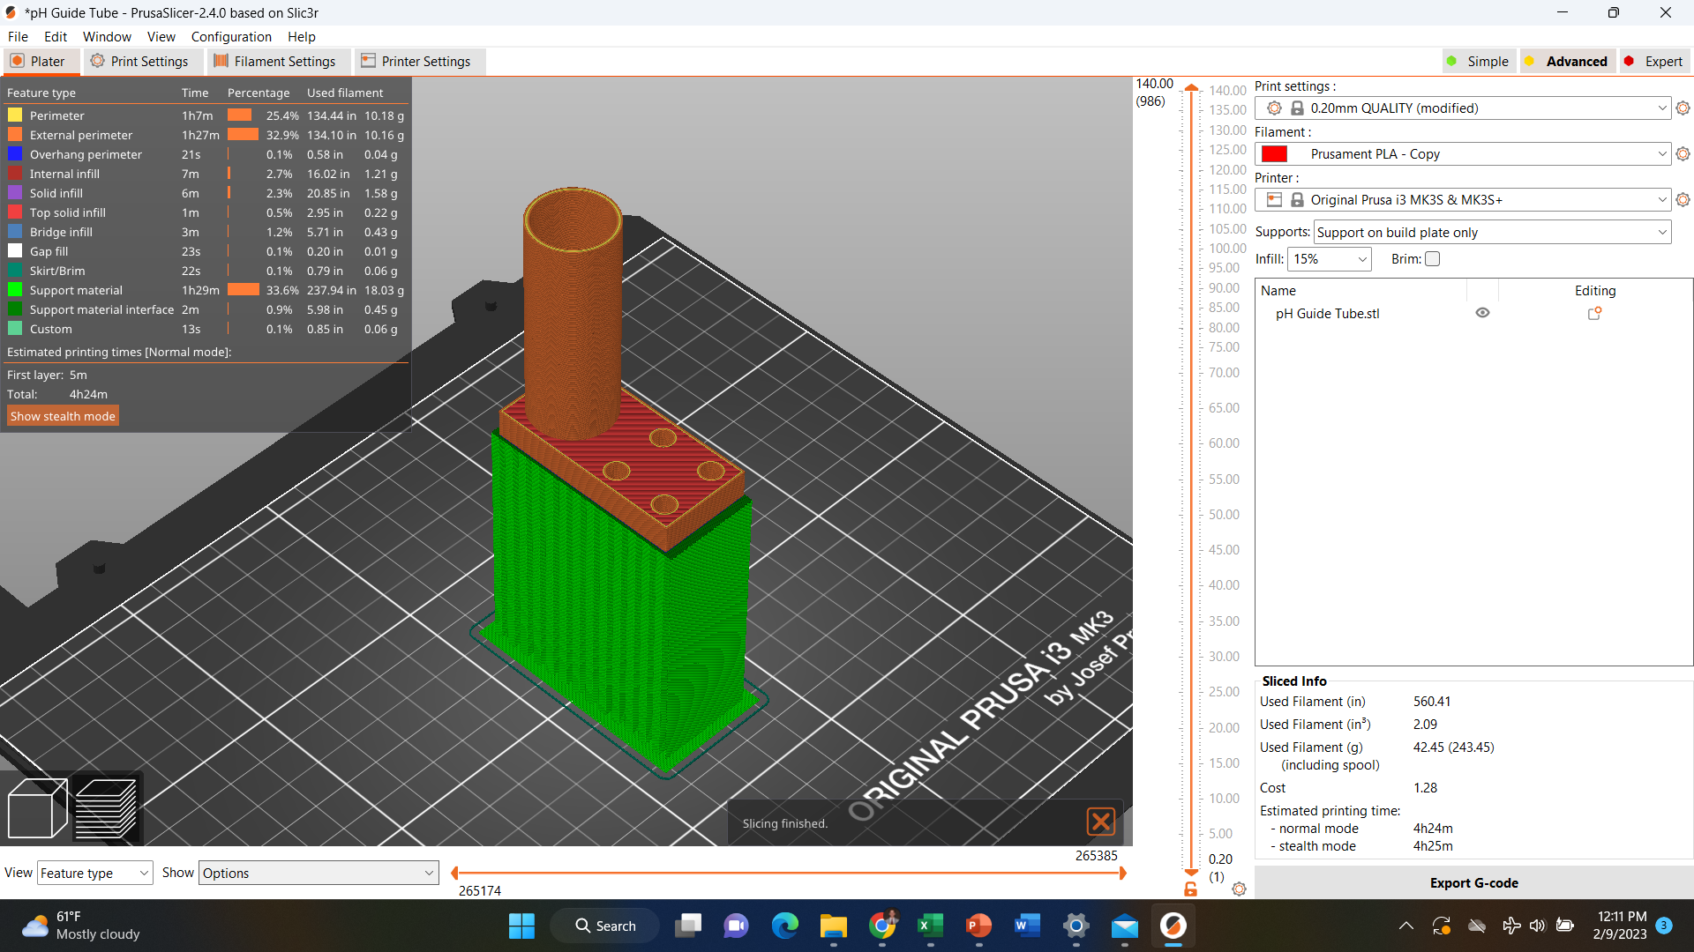
pH Sensor Guide Tube
Quantity Needed: 1
Supports: Yes (on build plate only)
Post processing: Remove support material carefully
PLA used: 42.45 g
Estimated PLA cost: $1.28
Estimated Print Time: 4.5 hours
Orientation
w/Supports
Longer Side

Slide 6
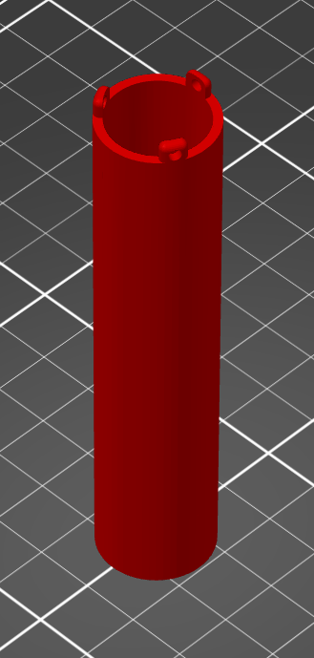
pH Sensor Sleeve
Quantity Needed: 1
Supports: None
Post processing: None
PLA used: 11.29 g
Estimated PLA cost: $0.34
Estimated Print Time: 1.5 hours
Orientation

Slide 7
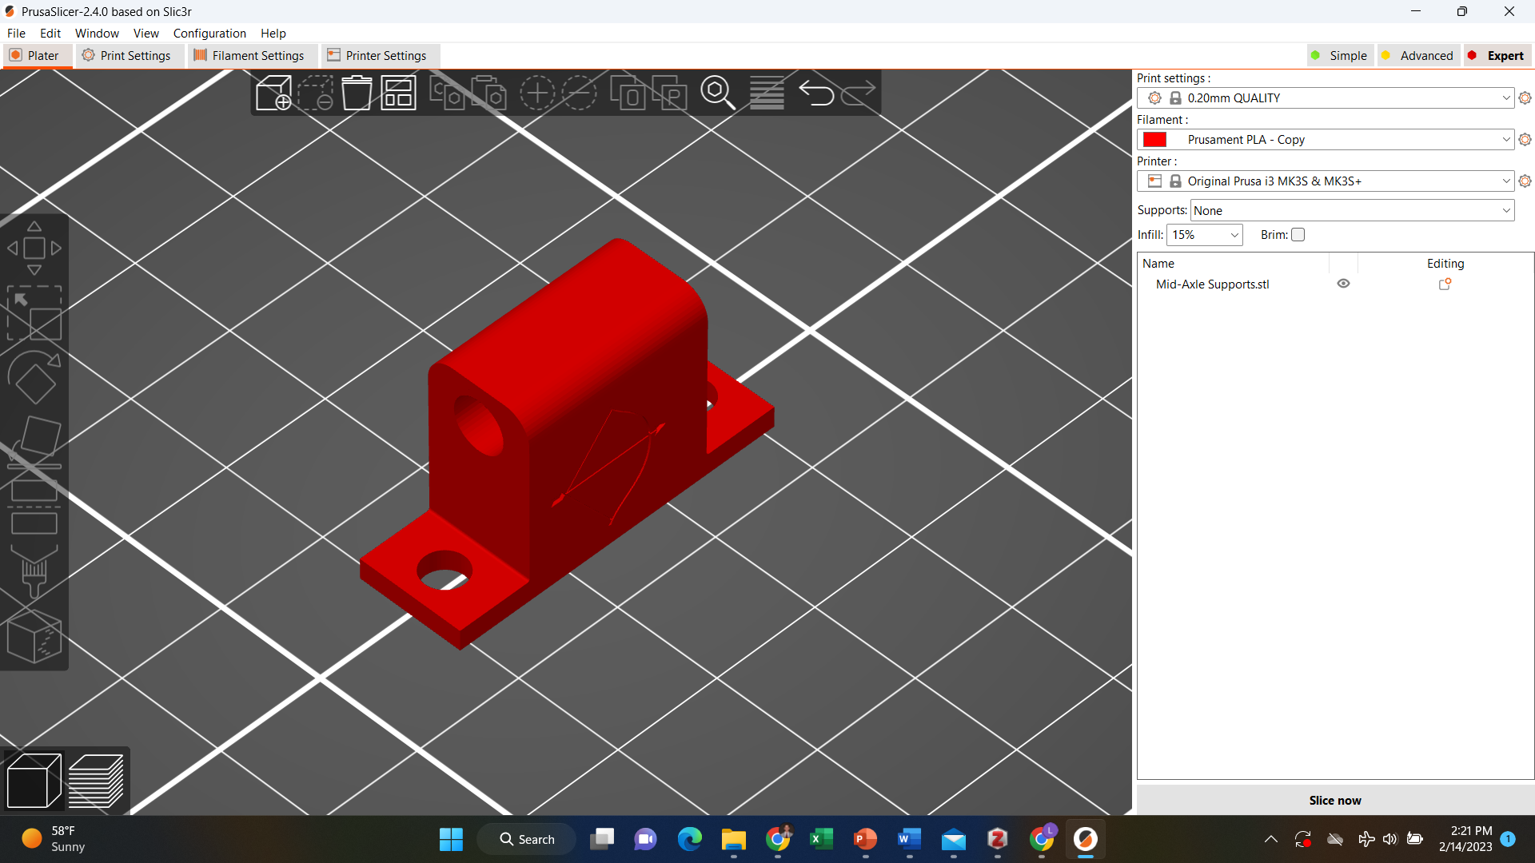
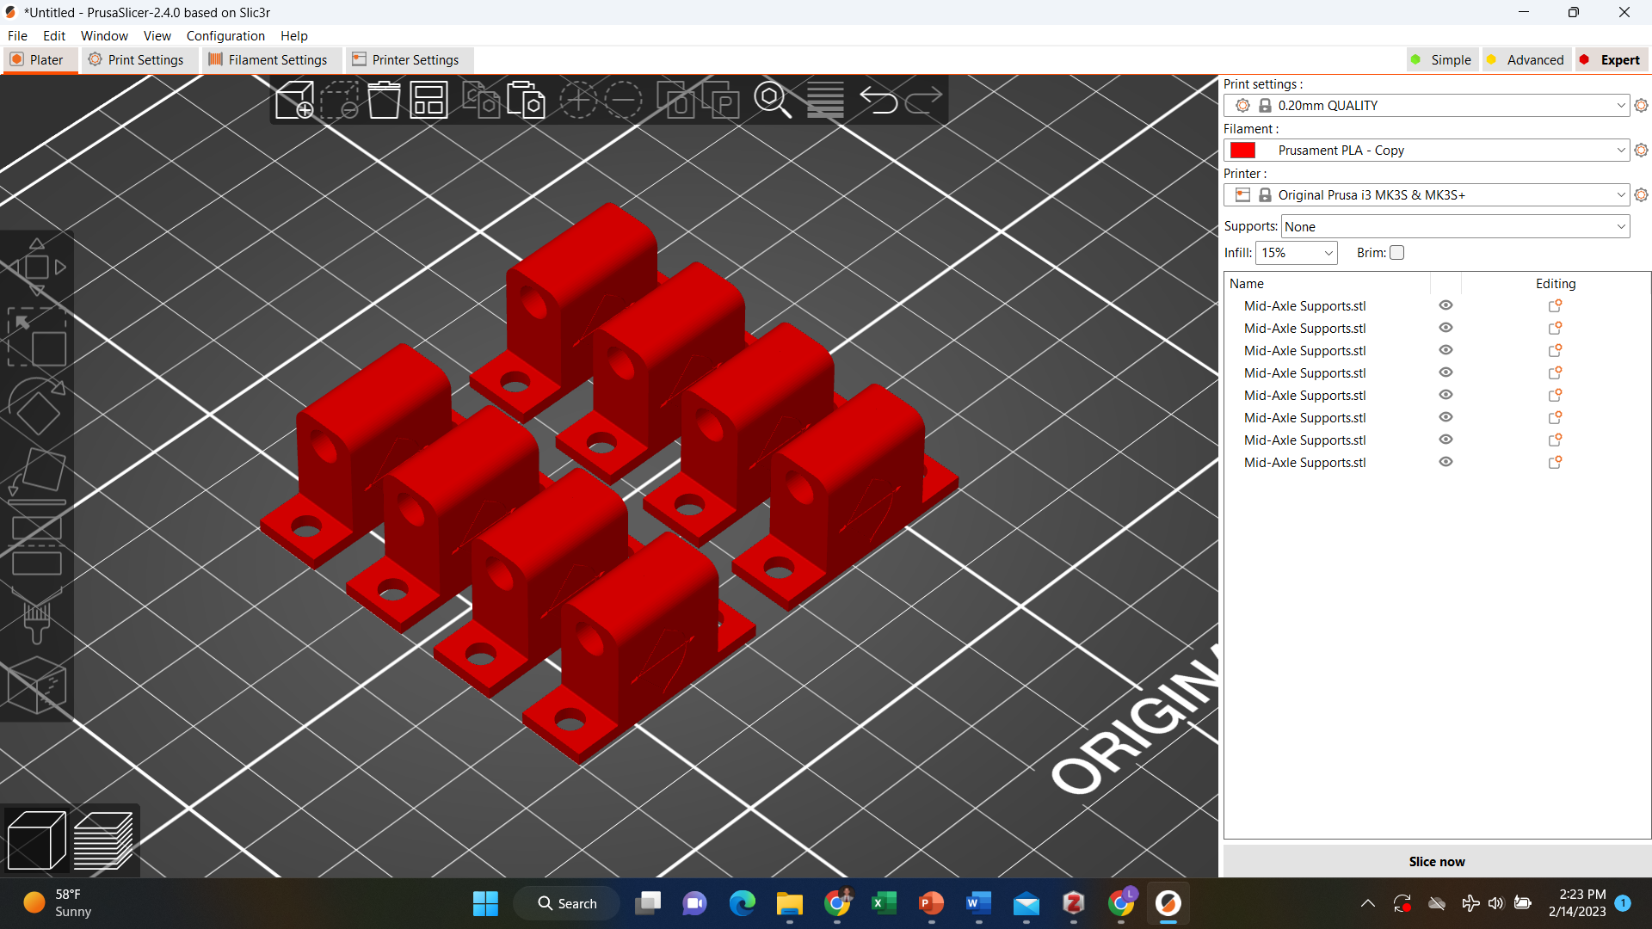
Mid-Axle Supports
Quantity Needed: 8
Supports: None
Post processing: Use drill press to bore out axle holes (5mm or 3/16”)
PLA used (8): 19.65 g
Estimated PLA cost (8): $0.59
Estimated Print Time (8): 2.25 hours
Orientation (single)
Orientation (all 8)

Slide 8
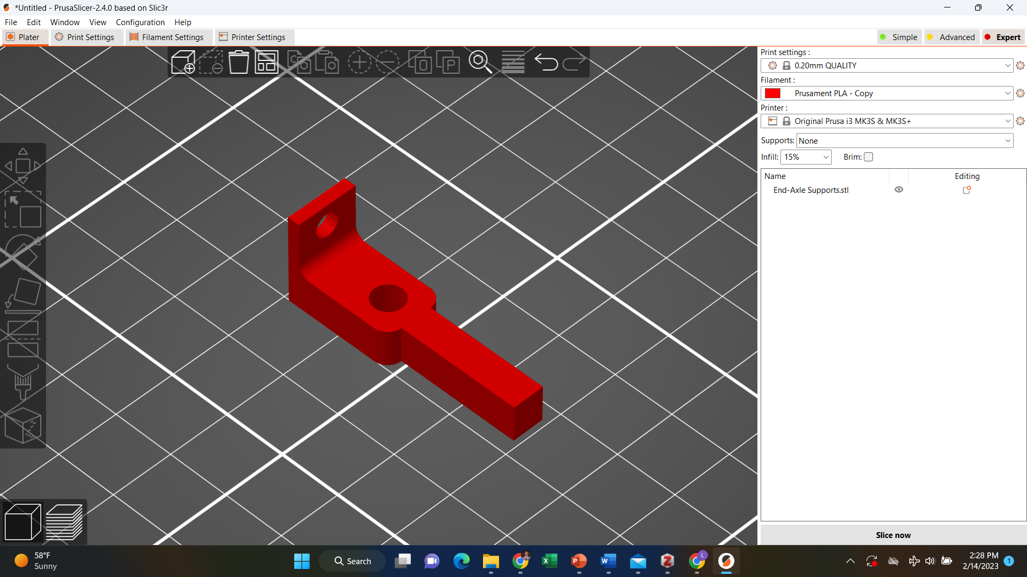
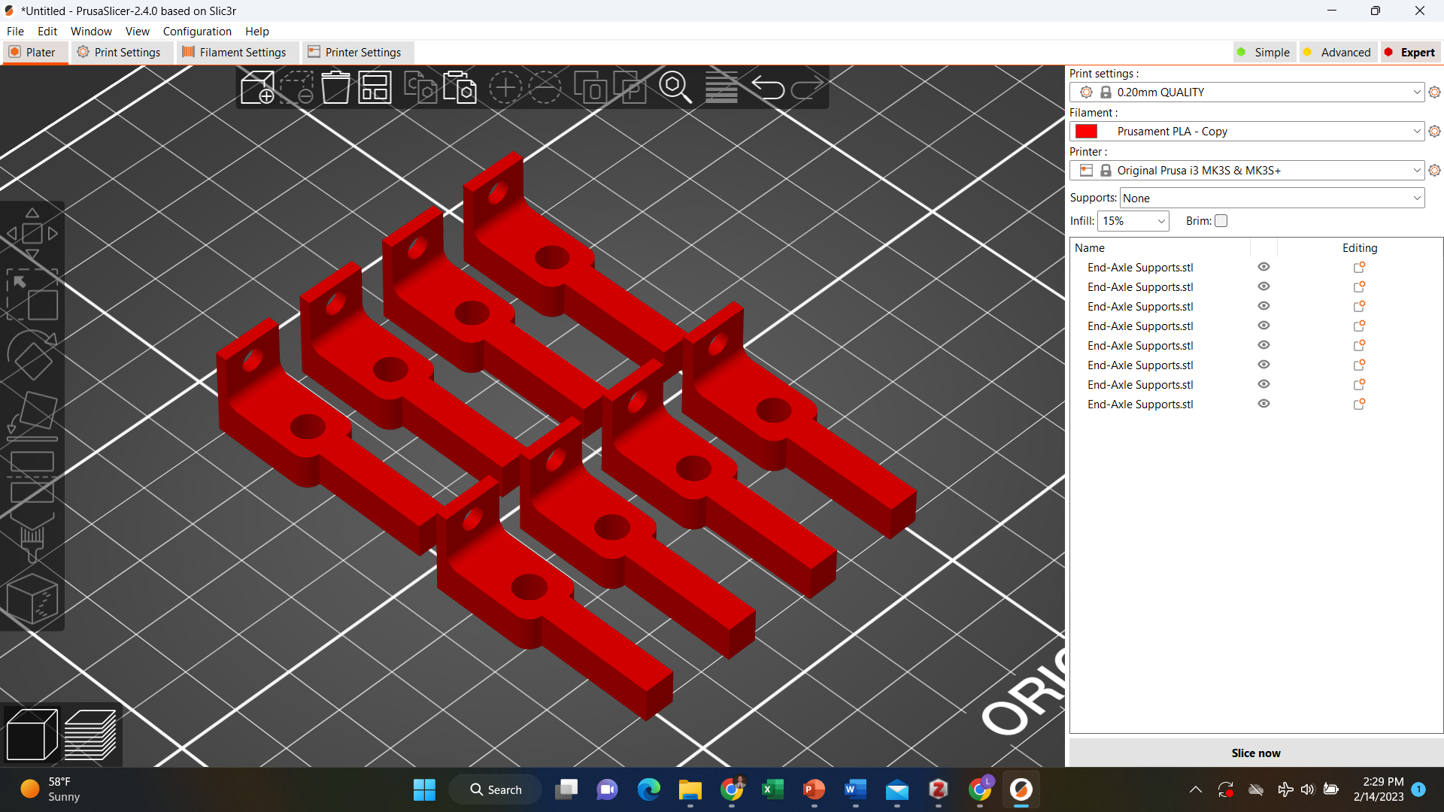
End-Axle Supports
Quantity Needed: 4
Supports: None
Post processing: None
PLA used (4): 12.21 g
Estimated PLA cost (4): $0.37
Estimated Print Time (4): 1.5 hours
Orientation (single)
Orientation (all 4)

Slide 9
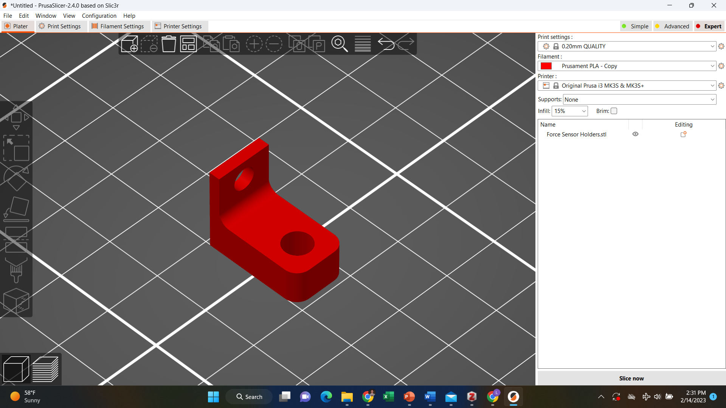
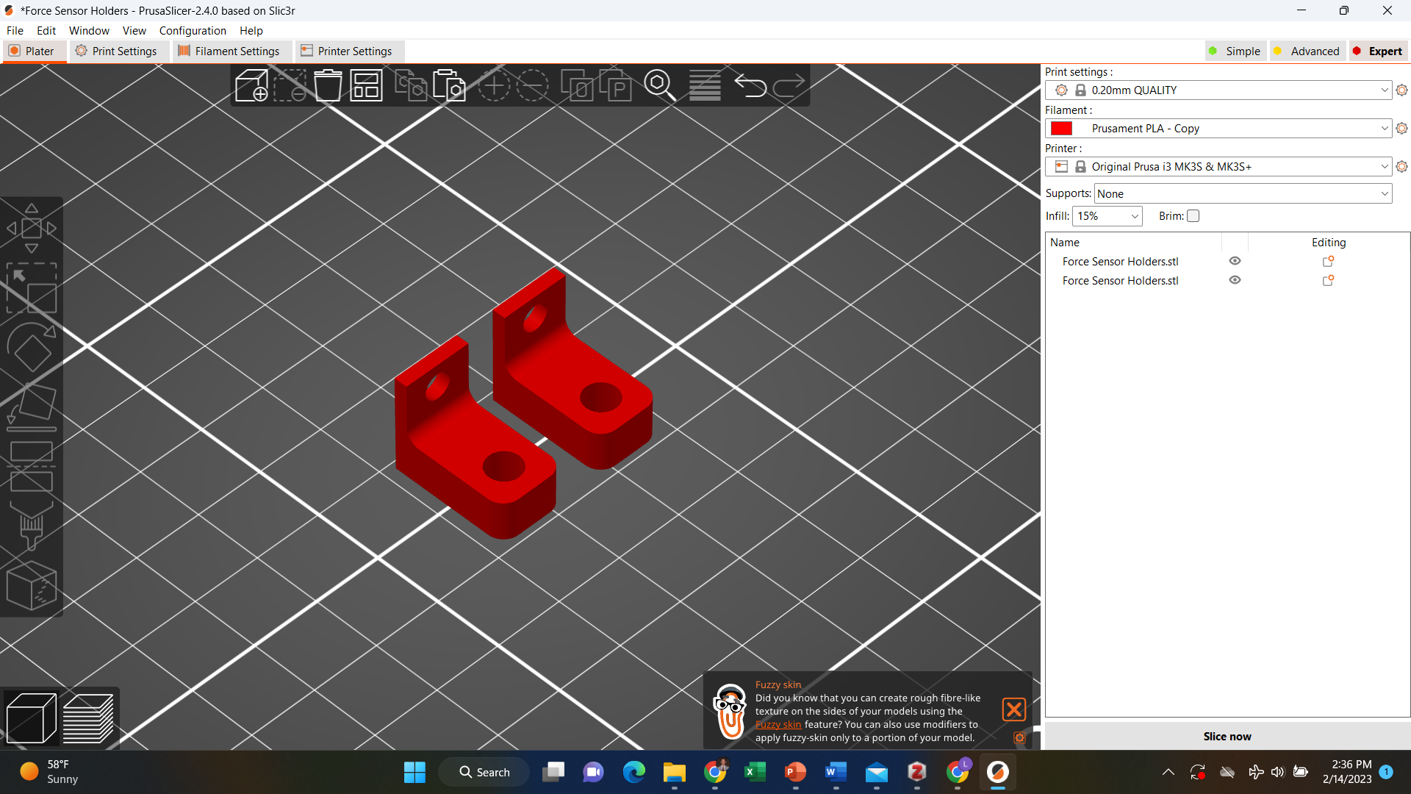
Force Sensor Holders
Quantity Needed: 2
Supports: None
Post processing: None
PLA used (2): 2.18 g
Estimated PLA cost (2): $0.07
Estimated Print Time (2): 0.33 hours
Orientation (single)
Orientation (all 2)

Slide 10
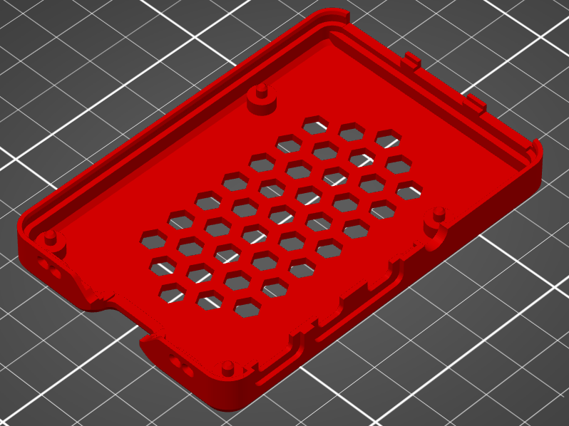
Raspberry Pi Case (Sourced From: https://www.thingiverse.com/thing:3723561)
Quantity Needed: 1
Supports: None
Post processing: None
PLA used (both parts): g
Estimated PLA cost (both parts): $
Estimated Print Time (both parts): 1.75 hours
Orientation

Slide 11
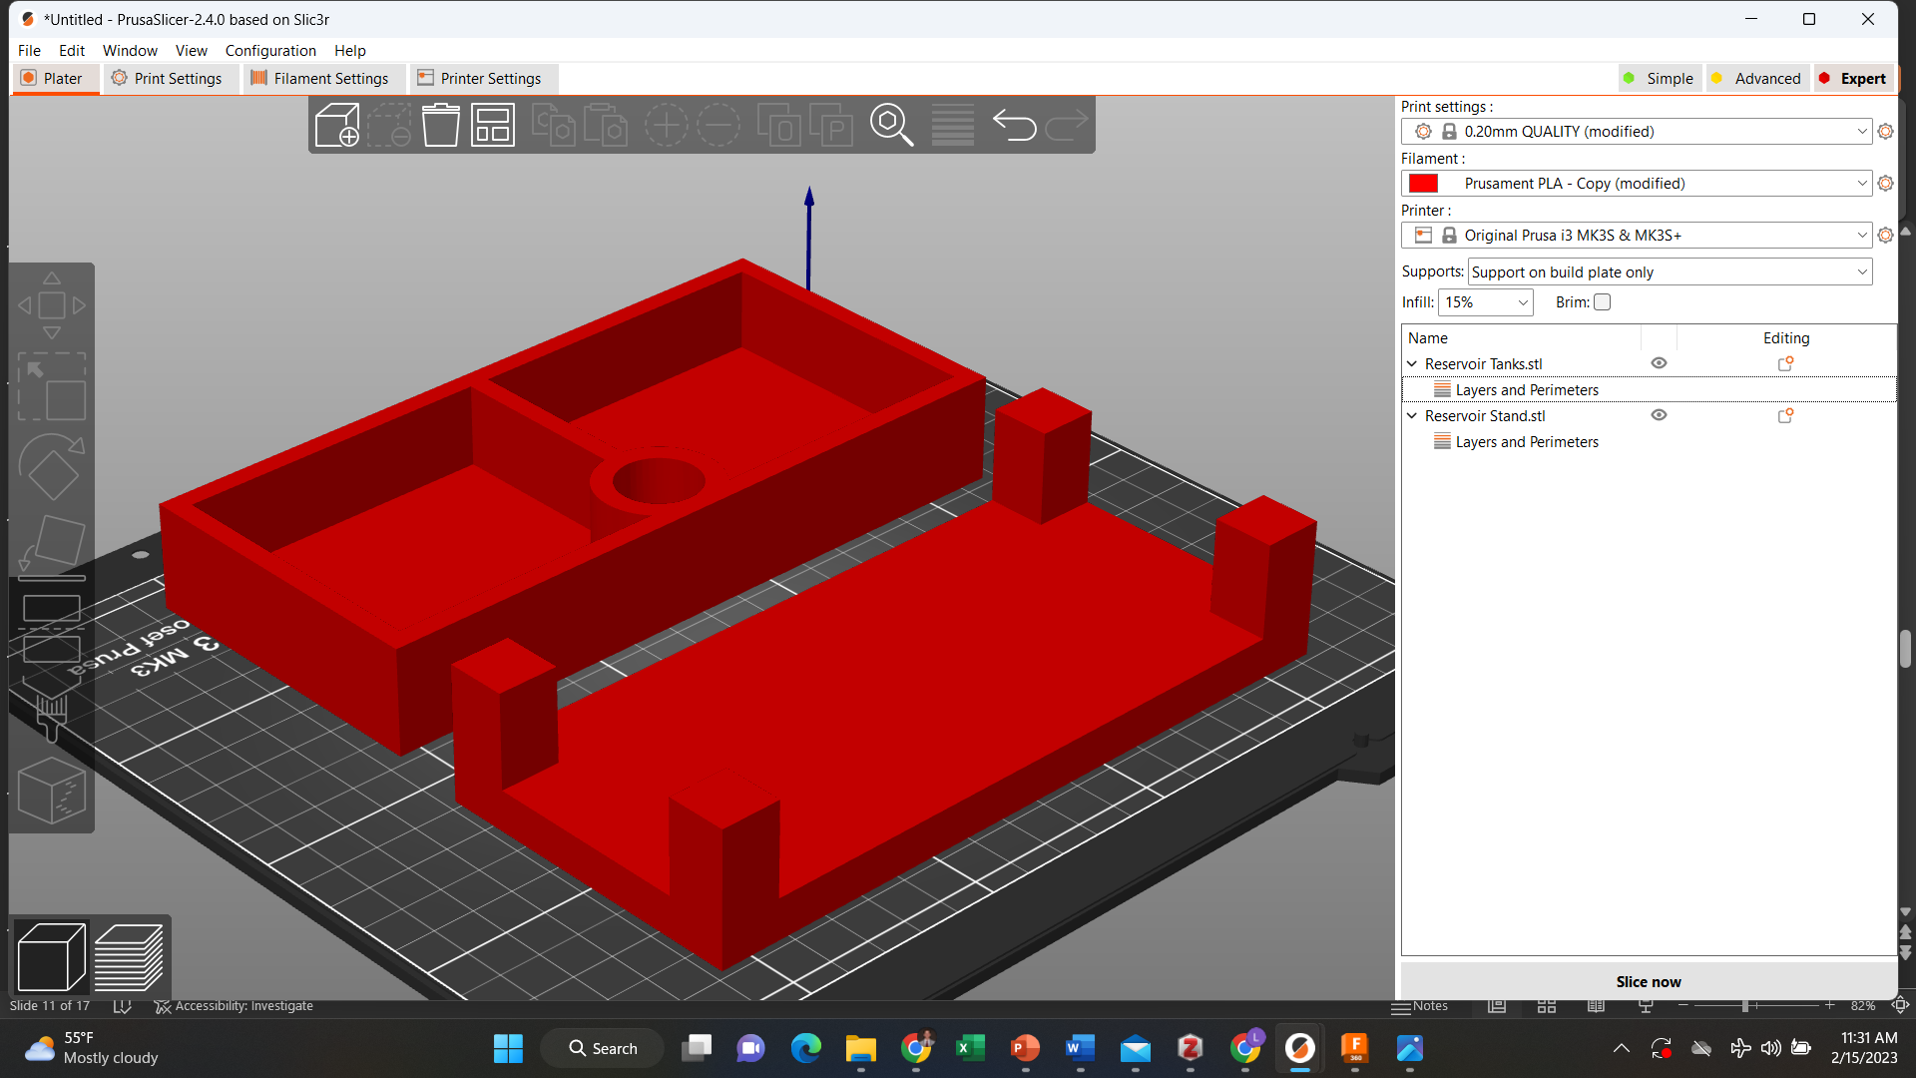
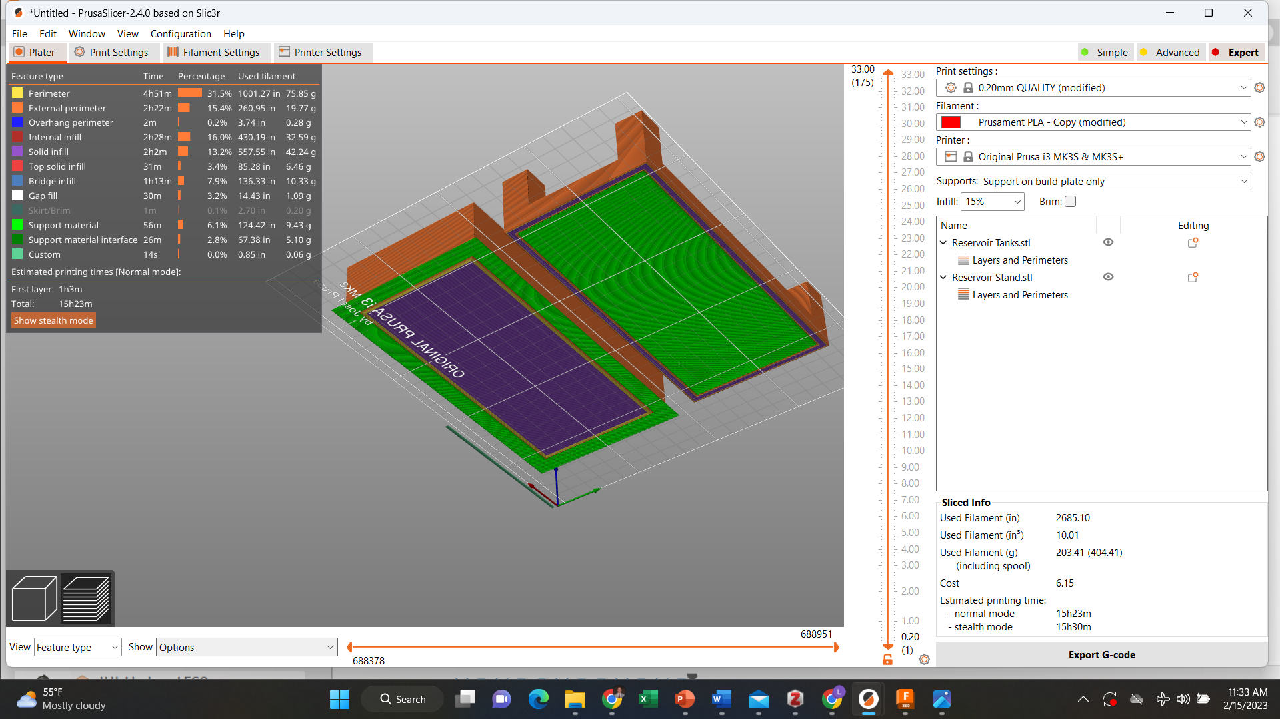
Reservoir Stand and Tanks
Printing Note:
The tanks hold water or weak acid/base solution, which can leak into the tank through micropores between layer lines or through polymeric swelling. To avoid this, print the tank with 5-6 perimeter and 5-6 solid bottom layers (i.e., no infill pattern). These settings are set in the “Reservoir Tanks and Stand” file if using a Prusa printer. Additionally, it can help to add an epoxy resin coating after printing.
Quantity Needed: 1 of each
Supports: Yes (on build plate only)
Post processing: Remove support material carefully
PLA used (2): 203.41 g
Estimated PLA cost (2): $6.15
Estimated Print Time (2): 15.5 hours
Orientation
w/Supports
Tanks
Stand

Slide 12
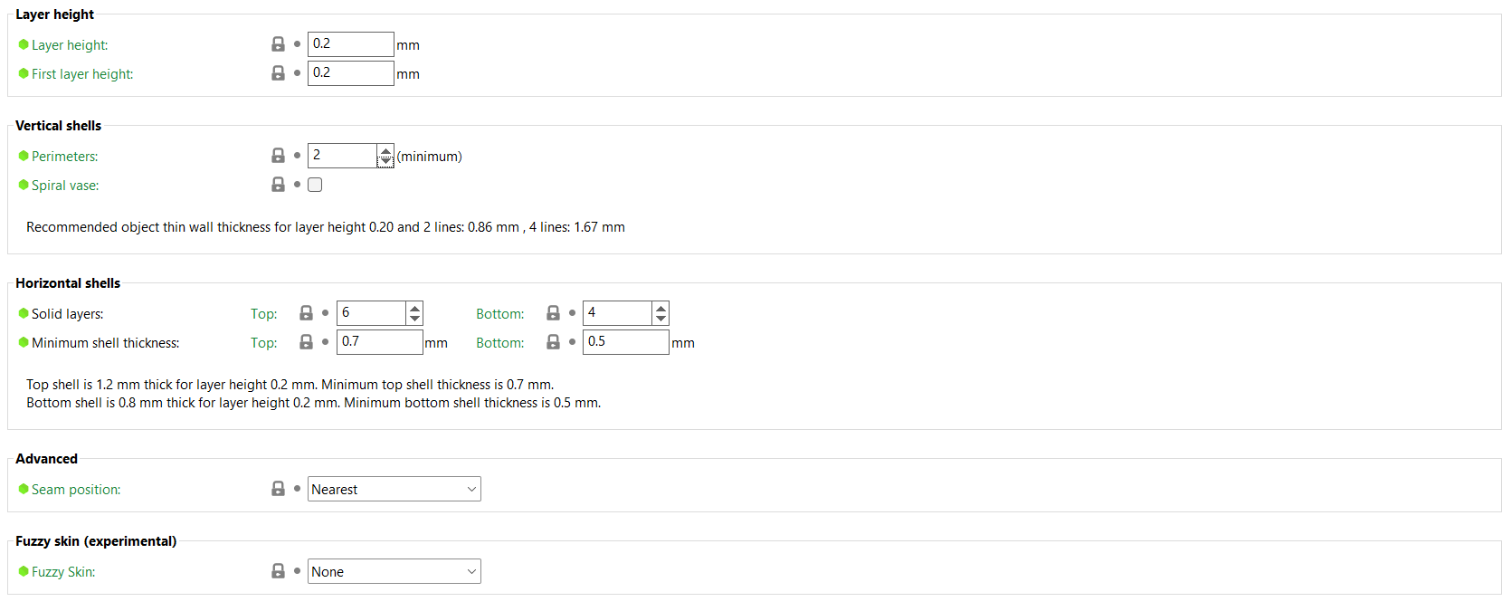
Additional Printing Details – Layers and Perimeters

Slide 13
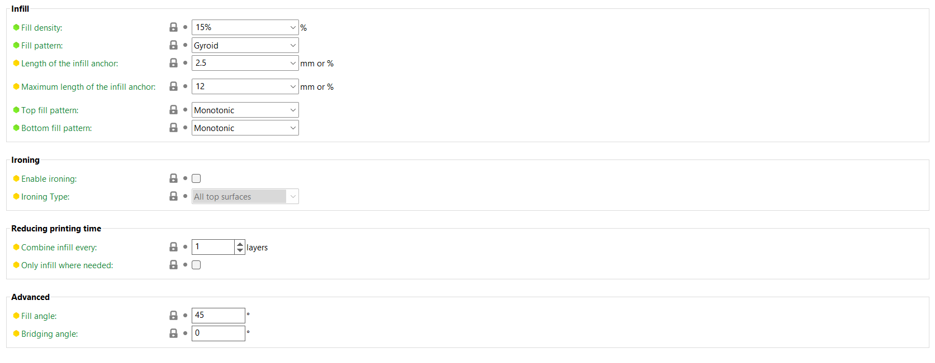
Additional Printing Details – Infill

Slide 14
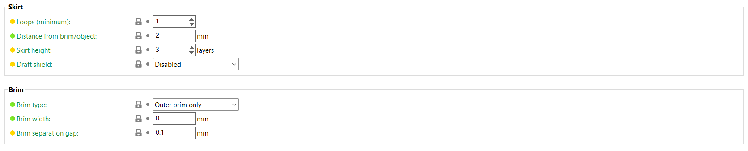
Additional Printing Details – Skirt & Brim

Slide 15
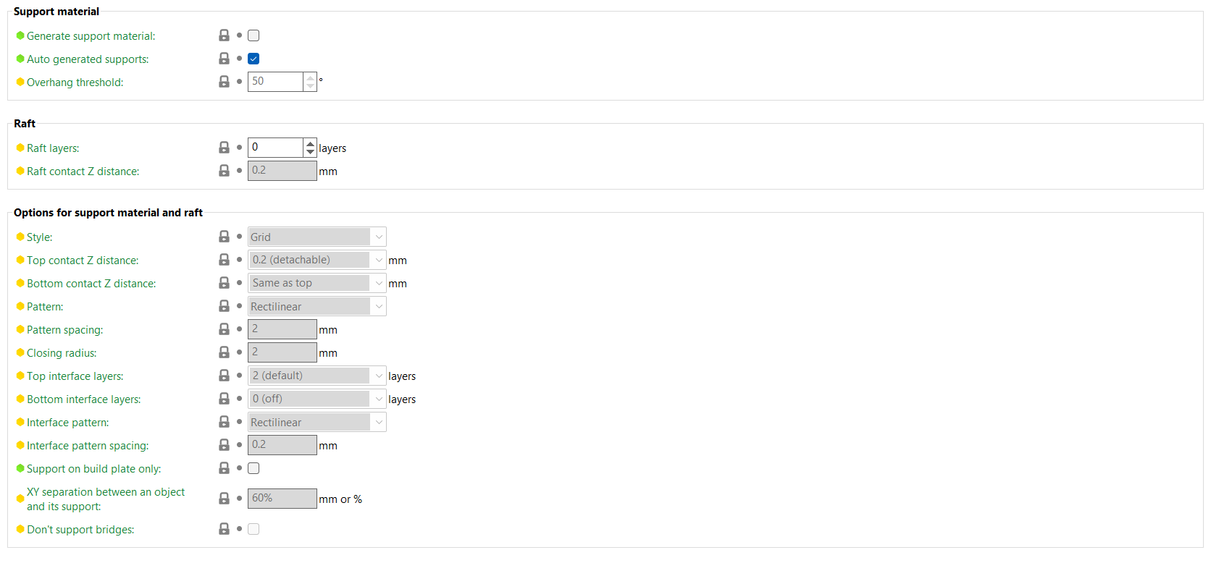
Additional Printing Details – Support Material

Slide 16
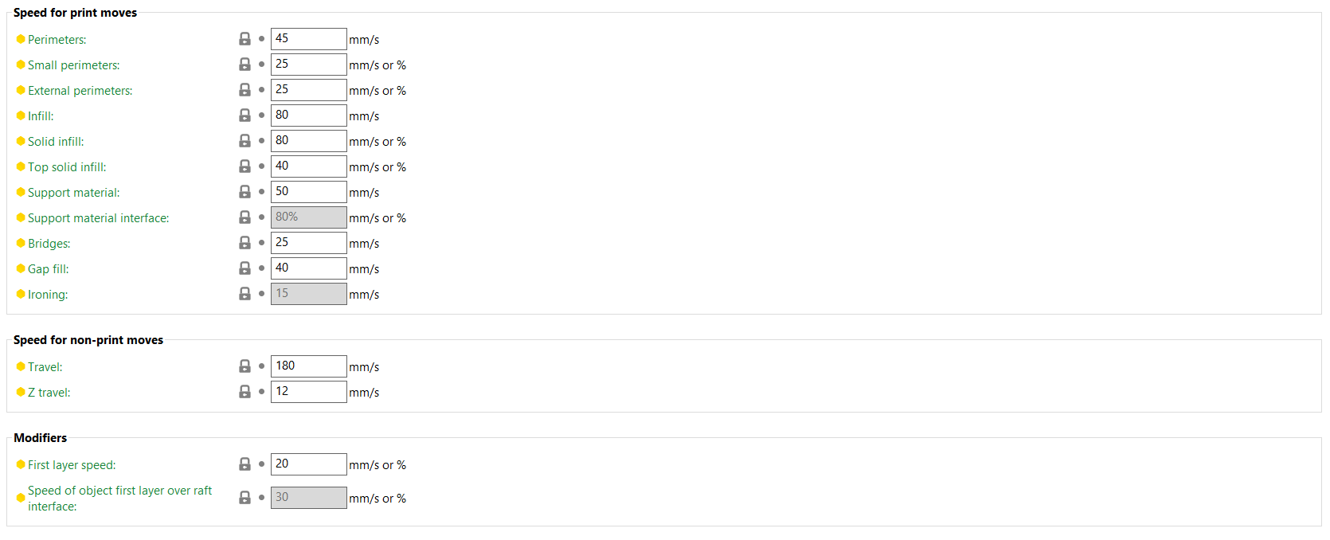
Additional Printing Details – Speed

